Slide 1
Procedure
ISA
Petterson: 3rd Edition Page 96 onwards

Slide 2
Procedures
Reusable code
Steps:
Place Parameters in a place where the procedure can access them
Transfer control to the procedure
Acquire the storage resources needed for the procedure
Perform the desired task
Place the result value in a place where the calling program can access it
Return control to the point of origin, since a procedure can be called from several points in a program
Notes:
Local variables, AR, $fp, $sp Scratchpad and saves/restores Arguments and returns jal and $ra

Slide 3
Registers
Out of 32 MIPS registers following will be learn
Regs 2-3 : $v0, $v1 return values of a procedure
Regs 4-7 : $a0-$a3 input arguments to a procedure
Reg 28 : $gp global pointer
Reg 29 : $sp stack pointer
Reg 30 : $fp frame pointer
Reg 31 : $ra return address

Slide 4
Control Instructions
Conditional Control Instructions
Branch: BEQ, BNE, SLT, SLTI
Unconditional Control Instructions
Jump: J, JR, JAL
JAL (Jump And Link)
Jal ProcedureAddress
Jumps to an address and simultaneously saves the address of the FOLLOWING Instruction (PC+4) in a register ($ra) to set up the procedure return
Since jal may over-write a relevant value in $ra, it must be saved before invoking the jal instruction
JR (Jump Register)
Jr $ra
Jumps to the address stored in register $ra

Slide 5
Procedures
Calling program or Caller
Puts the parameter values in $a0-$a3
Uses jal X to jump to procedure X (called the Callee)
Called program or Callee
Performs the calculations
Places the results in $v0-$v1
Returns control to the caller using jr $ra
NO! Not Sufficient…
Notes:
Local variables, AR, $fp, $sp Scratchpad and saves/restores Arguments and returns jal and $ra

Slide 6
Procedures
Each procedure (function, subroutine) maintains a scratchpad of register values
When another procedure is called (the callee),
New procedure takes over the scratchpad – values may have to be saved so we can safely return to the caller

Slide 7
Procedures
Suppose a compiler needs more registers for a procedure than the 4 argument and 2 return value registers
So, any registers needed by the caller must be restored to the values that they contained before the procedure was invoked
Need to spill registers to memory
Stack is the data structure to spill the registers
Which needs a pointer to the most recently allocated address in the stack to show where the next procedure should place the registers to be spilled or where the old register values are found
Stack pointer is adjusted by one word for each register that is saved or restored
$sp : used to save the registers needed by the callee
Stack grows from higher address to lower address
So, push values onto stack by subtracting from the stack pointer
Adding to the stack pointer shrinks the stack and pop the value off the stack
Notes:
Local variables, AR, $fp, $sp Scratchpad and saves/restores Arguments and returns jal and $ra

Slide 8
The Stack
The register scratchpad for a procedure seems volatile –
it seems to disappear every time we switch procedures –
a procedure’s values are therefore backed up in memory
on a stack
High address
Proc A’s values
Proc A
call Proc B
…
call Proc C
…
return
return
return
Proc B’s values
Proc C’s values
…
Stack grows
this way
Low address

Slide 9
Storage Management on a Call/Return – Saves & Restores
A new procedure must create space for all its variables on the stack
Before/after executing the jal, the caller/callee must save relevant
values in $s0-$s7, $a0-$a3, $ra, temps into the stack space
Arguments are copied into $a0-$a3; the jal is executed
After the callee creates stack space, it updates the value of $sp
Once the callee finishes, it copies the return value into $v0, frees
up stack space, and $sp is incremented
On return, the caller/callee brings in stack values, ra, temps into registers
The responsibility for copies between stack and registers may fall
upon either the caller or the callee

Slide 10
Example 1 (pg. 98)
proc_example:
addi $sp, $sp, -12
sw $t1, 8($sp)
sw $t0, 4($sp)
sw $s0, 0($sp)
add $t0, $a0, $a1
add $t1, $a2, $a3
sub $s0, $t0, $t1
add $v0, $s0, $zero
lw $s0, 0($sp)
lw $t0, 4($sp)
lw $t1, 8($sp)
addi $sp, $sp, 12
jr $ra
int proc_example (int g, int h, int i, int j)
{
int f ;
f = (g + h) – (i + j); // $t0=g+h, $t1=i+j, f is $s0
return f;
}
Notes:
In this example, the callee took care of
saving the registers it needs.
The caller took care of saving its $ra and
$a0-$a3.
Could have avoided using the stack altogether.
Caller saved: Temp registers $t0-$t9 (the callee won’t bother saving these, so save them if you care), $ra (it’s about to get over-written), $a0-$a3 (so you can put in new arguments)
Callee saved: $s0-$s7 (these typically contain “valuable” data)

Slide 11
Example 2 (pg. 101)
int fact (int n)
{
if (n < 1) return (1);
else return (n * fact(n-1));
}
fact:
slti $t0, $a0, 1
beq $t0, $zero, L1
addi $v0, $zero, 1
jr $ra
L1:
addi $sp, $sp, -8
sw $ra, 4($sp)
sw $a0, 0($sp)
addi $a0, $a0, -1
jal fact
lw $a0, 0($sp)
lw $ra, 4($sp)
addi $sp, $sp, 8
mul $v0, $a0, $v0
jr $ra
Fact is recursive procedure
The earlier procedure proc_example is called leaf procedure as do not call others
Notes:
The caller saves $a0 and $ra
in its stack space.
Temp register $t0 is never saved.
MUL is just the assumption that MIPS 32 is having this instruction

Slide 12
Global Pointer $gp
‘C’ has two storage classes
Automatic and Static
Automatic Variables
Local to a procedure and are discarded when the procedure exits
Static Variables
Exist across exits from and entries to procedures
Variables declared outside all procedures are considered static, as are any variables declared using the keyword static and rest are automatic
$gp
The register that is reserved to point to static data

Slide 13
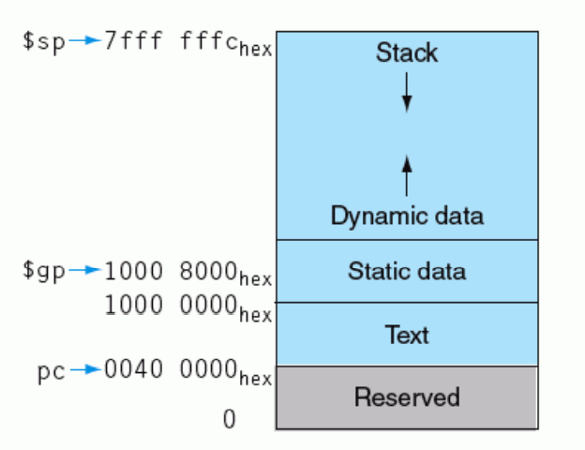
MIPS Memory Allocation for Program and Data
Heap for pointers
Home of MIPS machine code

Slide 14
Dealing with Characters
Instructions are also provided to deal with byte-sized
and half-word quantities: lb (load-byte), sb, lh, sh
These data types are most useful when dealing with
characters, pixel values, etc.
C employs ASCII formats to represent characters – each
character is represented with 8 bits and a string ends in
the null character (corresponding to the 8-bit number 0);
A is 65, a is 97

Slide 15
Example 3 (pg. 108)
Convert to assembly:
void strcpy (char x[], char y[])
{
int i;
i=0;
while ((x[i] = y[i]) != `\0’)
i += 1;
}
strcpy:
addi $sp, $sp, -4
sw $s0, 0($sp)
add $s0, $zero, $zero
L1: add $t1, $s0, $a1
lb $t2, 0($t1)
add $t3, $s0, $a0
sb $t2, 0($t3)
beq $t2, $zero, L2
addi $s0, $s0, 1
j L1
L2: lw $s0, 0($sp)
addi $sp, $sp, 4
jr $ra
Notes:
Temp registers not saved.

Slide 16
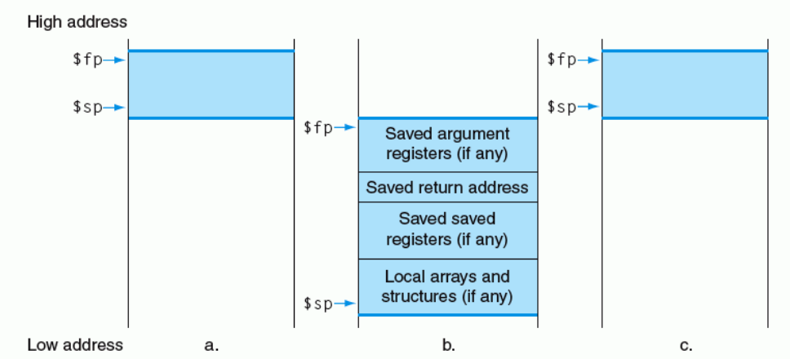
Frame Pointer $fp
Stack Allocation (a) before, (b) during and ( c) after the procedure call
$fp points to the first word of the frame, often a saved argument register
As the stack pointer may change during program execution due to number of variables, it’s easier for programmers to reference variables via the stable frame pointer, although it could be done just with the stack pointer and a little address arithmetic
If there are no local variables on the stack within a procedure, the compiler will save time by not setting and restoring the frame pointer
When a frame pointer is used, it is initialized using the address in $sp on a call, and $sp is restored using $fp

Slide 17
Large Constants
Immediate instructions can only specify 16-bit constants
The lui instruction is used to store a 16-bit constant into
the upper 16 bits of a register… combine this with an
OR instruction to specify a 32-bit constant
The destination PC-address in a conditional branch is
specified as a 16-bit constant, relative to the current PC
A jump (j) instruction can specify a 26-bit constant; if more
bits are required, the jump-register (jr) instruction is used

Slide 18
Full Example – Sort in C
void sort (int v[ ], int n)
{
int i, j;
for (i=0; i<n; i+=1) {
for (j=i-1; j>=0 && v[j] > v[j+1]; j-=1) {
swap (v,j);
}
}
}
void swap (int v[ ], int k)
{
int temp;
temp = v[k];
v[k] = v[k+1];
v[k+1] = temp;
}
Allocate registers to program variables
Produce code for the program body
Preserve registers across procedure invocations

Slide 19
The swap Procedure
Register allocation: $a0 and $a1 for the two arguments, $t0 for the
temp variable – no need for saves and restores as we’re not using
$s0-$s7 and this is a leaf procedure (won’t need to re-use $a0 and $a1)
swap: sll $t1, $a1, 2
add $t1, $a0, $t1
lw $t0, 0($t1)
lw $t2, 4($t1)
sw $t2, 0($t1)
sw $t0, 4($t1)
jr $ra
void swap (int v[], int k)
{
int temp;
temp = v[k];
v[k] = v[k+1];
v[k+1] = temp;
}

Slide 20
The sort Procedure
Register allocation: arguments v and n use $a0 and $a1, i and j use
$s0 and $s1; must save $a0 and $a1 before calling the leaf
procedure
The outer for loop looks like this: (note the use of pseudo-instrs)
move $s0, $zero # initialize the loop
loopbody1: bge $s0, $a1, exit1 # will eventually use slt and beq
… body of inner loop …
addi $s0, $s0, 1
j loopbody1
exit1:
for (i=0; i<n; i+=1) {
for (j=i-1; j>=0 && v[j] > v[j+1]; j-=1) {
swap (v,j);
}
}

Slide 21
The sort Procedure
The inner for loop looks like this:
addi $s1, $s0, -1 # initialize the loop
loopbody2: blt $s1, $zero, exit2 # will eventually use slt and beq
sll $t1, $s1, 2
add $t2, $a0, $t1
lw $t3, 0($t2)
lw $t4, 4($t2)
ble $t3, $t4, exit2
… body of inner loop …
addi $s1, $s1, -1
j loopbody2
exit2:
for (i=0; i<n; i+=1) {
for (j=i-1; j>=0 && v[j] > v[j+1]; j-=1) {
swap (v,j);
}
}

Slide 22
Saves and Restores
Since we repeatedly call “swap” with $a0 and $a1, we begin “sort” by
copying its arguments into $s2 and $s3 – must update the rest of the
code in “sort” to use $s2 and $s3 instead of $a0 and $a1
Must save $ra at the start of “sort” because it will get over-written when
we call “swap”
Must also save $s0-$s3 so we don’t overwrite something that belongs
to the procedure that called “sort”

Slide 23
Saves and Restores
sort: addi $sp, $sp, -20
sw $ra, 16($sp)
sw $s3, 12($sp)
sw $s2, 8($sp)
sw $s1, 4($sp)
sw $s0, 0($sp)
move $s2, $a0
move $s3, $a1
…
move $a0, $s2 # the inner loop body starts here
move $a1, $s1
jal swap
…
exit1: lw $s0, 0($sp)
…
addi $sp, $sp, 20
jr $ra
9 lines of C code 🡪 35 lines of assembly

